Slide 1
Brain Vessel Abnormality Detection
Ousman Bah, Folabomi Longe,
Karen Maza Delgado, Maria Garcia,
Chimin Liu
Notes:
Everyone unmute to introduce themselves

Slide 2
Table of contents
1
Project Overview
4
Data Preparation
2
Dataset
5
AI Model
3
Source of Bias
6
FrontEnd DEV
Notes:
Fola

Slide 3
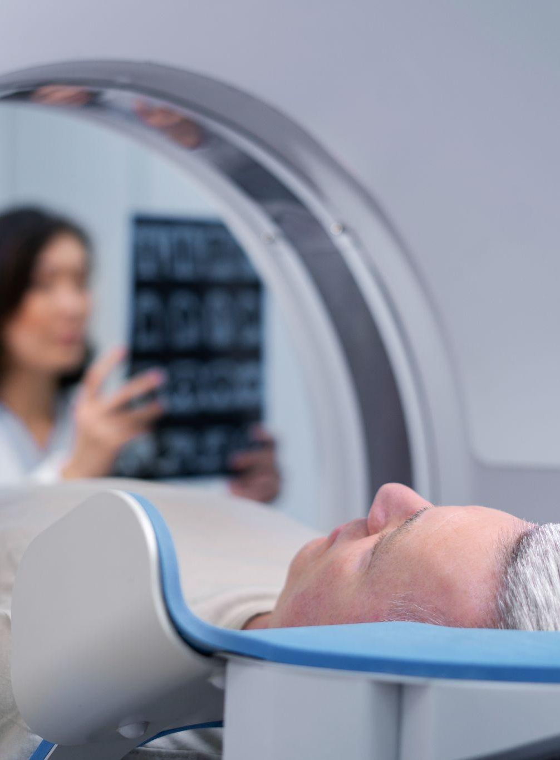
1
Project
Overview
Notes:
Fola

Slide 4
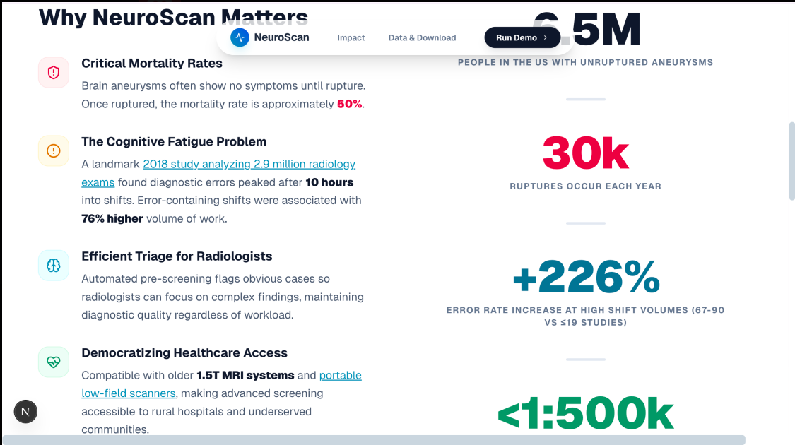
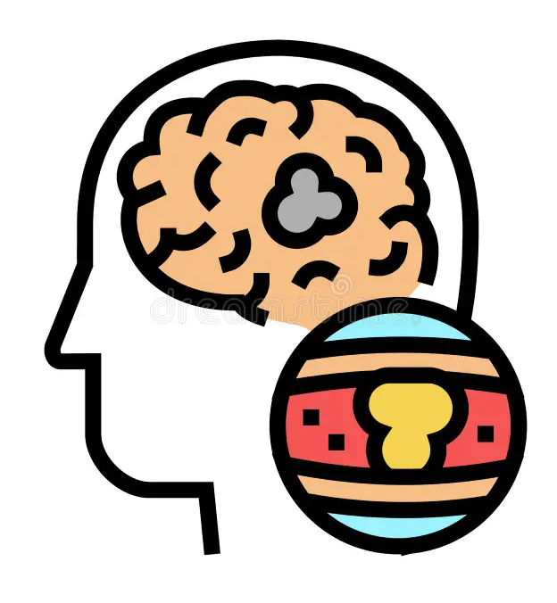

Understanding Aneurysms and
MRA Scans
Why are MRA Scans Important?
They provide detailed images of blood vessels to diagnose and monitor a vascular conditions like aneurysms, blockages and arterial disease, without using ionizing radiation
Assessing blood flow in specific areas such as the brain, lungs and heart
Monitor changes in blood vessels over time
Notes:
Fola

Slide 5
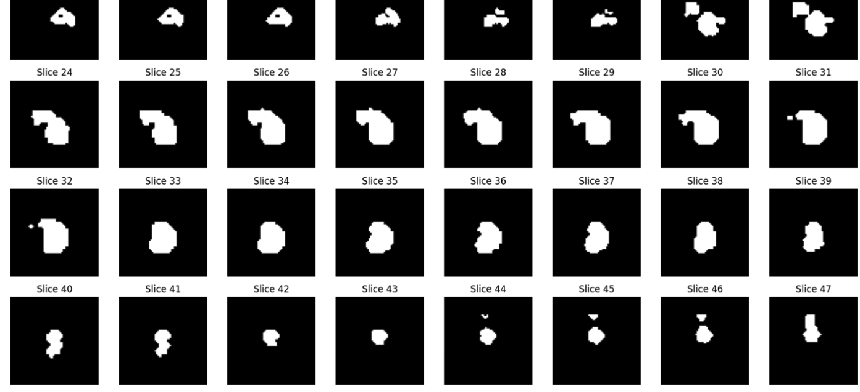
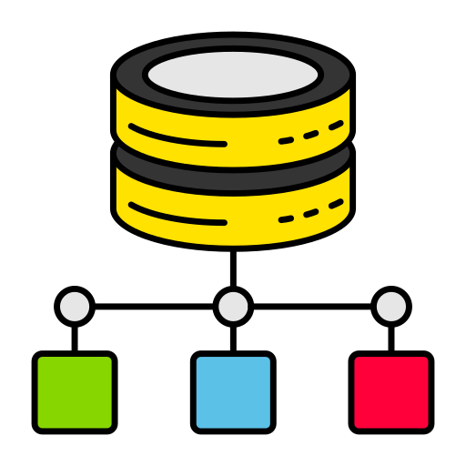
Dataset: VesselMNIST3D
Class Distribution:
Dataset Characteristics
Size: 382 test samples
Format: 64 × 64 × 64 voxels (grayscale 3D volumes)
Class 0 (Healthy): 339 samples (88.7%)
Class 1 (Aneurysm): 43 samples (11.3%)
Notes:
Fola

Slide 6


Sources of Bias
Limited Resolution size
Unbalanced Ratio
Unknown Patient demographics
The images are significantly small and can lead to issues in classification.
Unknown patient demographics (age, sex, ethnicity, location) may cause bias.
Healthy samples were (88.7%) and only(11.3%) was for 43 aneurysm samples (11.3%)
Notes:
Fola

Slide 7
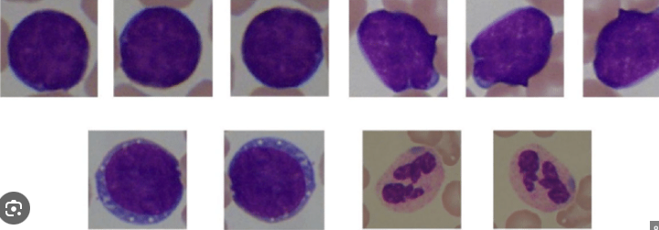

Data Cleaning & Augmentation
Cleaning
Augmentation
Verified data integrity (no missing values, no corrupted images)
Normalized pixel intensities from [0, 255] to [0, 1]
Converted data type from uint8 to float32 (for PyTorch/MONAI
compatibility)
Validated binary labels (0/1) and class distribution
WHY: To address the severely limited aneurysm samples (only 43 in test set) and reduce overfitting risk by artificially expanding the training data diversity.
Steps:
Random 90° Rotations - Model learns aneurysms at different angles
Random Flipping - Horizontal, vertical, and depth flips create mirror images
Intensity Scaling - Simulates different MRI machine settings
Intensity Shifting - Adjusts brightness/contrast variations
Notes:
Maria
Before training any models, we focused on preparing the data properly. For cleaning, we first verified that all scans were valid; no missing values and no corrupted images. We standardized the pixel intensities to a 0-1 range, and we converted everything to float32 so it would run smoothly in Pytorch and MONAI. We also double checked our binary labels to make sure there were no mismatches. For augmentation, our biggest challenge was the extremely small number of aneurysm cases. This creates a huge risk of overfitting. To address that, we artificially expanded the dataset using rotations, flips, intensity scaling, and intensity shifting. These make the model more robust because it learns to recognize aneurysms across different imaging conditions and orientations.

Slide 8
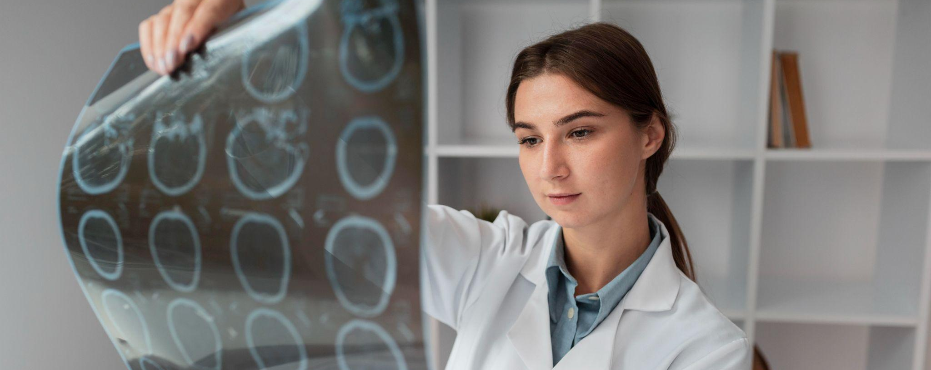

MODEL IMPLEMENTATION
&
EVALUATION
Notes:
Ousman 8-11

Slide 9
AI Model
Model
Architecture
Flow
Processing
Why ResNet-18 with MONAI?
Output
Algorithm Type
3D ResNet-18 (MONIA)
3D Convolutional Layers with Batch Normalization & ReLU activation.
Max Pooling for downsampling
ResNet Blocks (18 layers) with skip connections help model train deep
Global Average Pooling
Fully Connected Layer
Input: 64×64×64×1 grayscale volume (3D MRA scan)
3D Neural Network with 18 layers.
Specialized deep learning architecture for medical imaging
2-class probability (Class 0: Healthy, Class 1: Aneurysm)
Supervised Learning (Deep Learning CNN)
Notes:
Ousman

Slide 10
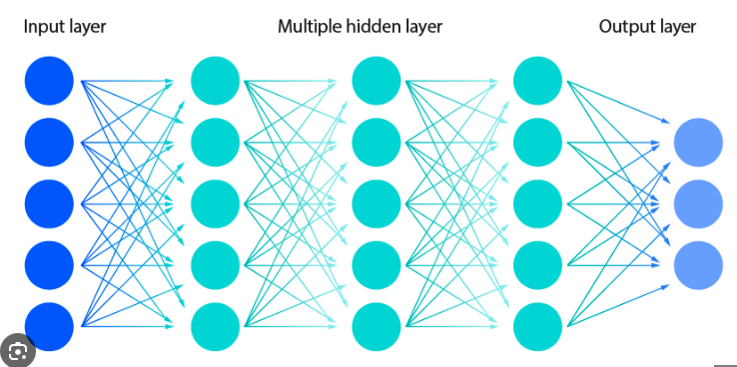
Training Outcome
To address the severe class imbalance, we trained 5 different model versions, each with different penalties for missing aneurysms:
V1: Class Weight 8.0, Threshold 0.35
V2: Class Weight 12.0, Threshold 0.55
V3: Class Weight 9.5, Threshold 0.35
V4: Class Weight 8.5, Threshold 0.25
V5: Class Weight 7.5, Threshold 0.55
Notes:
Ousman

Slide 11
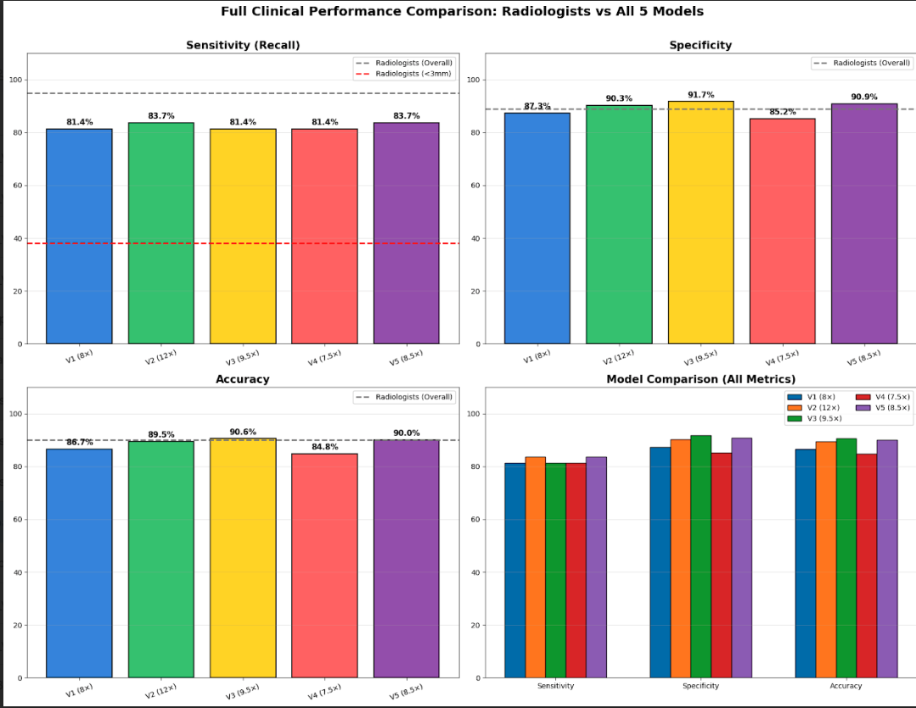
Model Results
Model | Accuracy | Recall | Precision | Missed
V1 (8.0) | 86.65% | 81.40% | 44.87% | 8
V2(12.0) | 89.53% | 83.72% | 52.17% | 7
V3(9.0) | 90.58% | 81.40% | 55.56% | 8
V4(8.5) | 84.82% | 81.40% | 41.18% | 8
V5(7.5) | 90.05% | 83.72% | 53.73% | 7
Why We Chose V5:
Tied for best recall (83.72%) - catches the most aneurysms
Only 7 missed aneurysms (fewest false negatives)
Strong precision (53.73%) - balanced false alarm rate
Notes:
Ousman

Slide 12

Bias Mitigation
✓ Transparent Evaluation - Tested 5 models, reported all metrics (not just accuracy)
✓ Prioritized Patient Safety - High recall (83.72%) reduces missed life-threatening cases
✓ Documented Limitations - Clearly stated dataset biases and generalization concerns
✓ Designed as Assistive Tool - Supports (not replaces) radiologists' judgment
✓ Systematic Approach - Used class weights and data augmentation to address imbalance
Notes:
Maria
To reduce bias and improve fairness, we followed several mitigation strategies. First, we focused on transparent evaluation. Instead of reporting just accuracy, we evaluated five different models across all metrics. Second, we prioritized patient safety. That means we emphasize recall because missing an aneurysm CAN be life-threatening. We also documented the limits of our dataset; for example, the low resolution and class imbalance, so users understand the constraints. Most importantly, our model is designed as an assistive tool. It supports radiologists, not replaces them. And finally, we used class weights and data augmentation to help balance the underrepresented aneurysm cases.

Slide 13
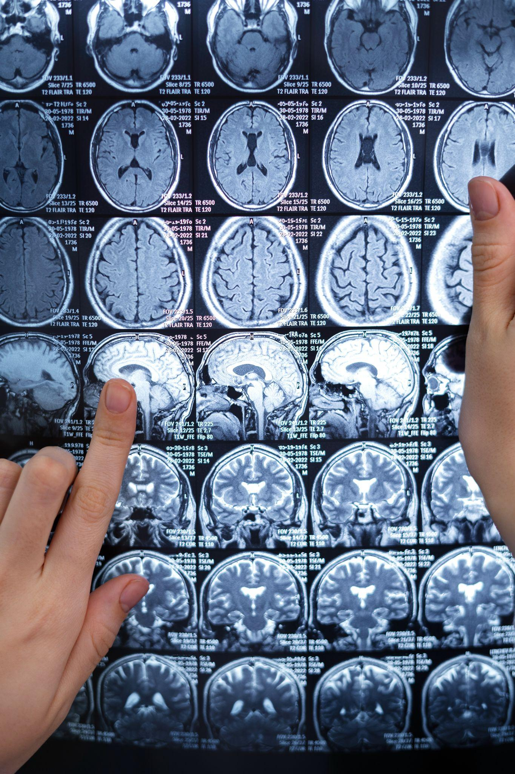

4
DEPLOYMENT
Notes:
Karen: Once our model was developed our next step was to turn the Google Colab model into a stable, public-facing web application.

Slide 14
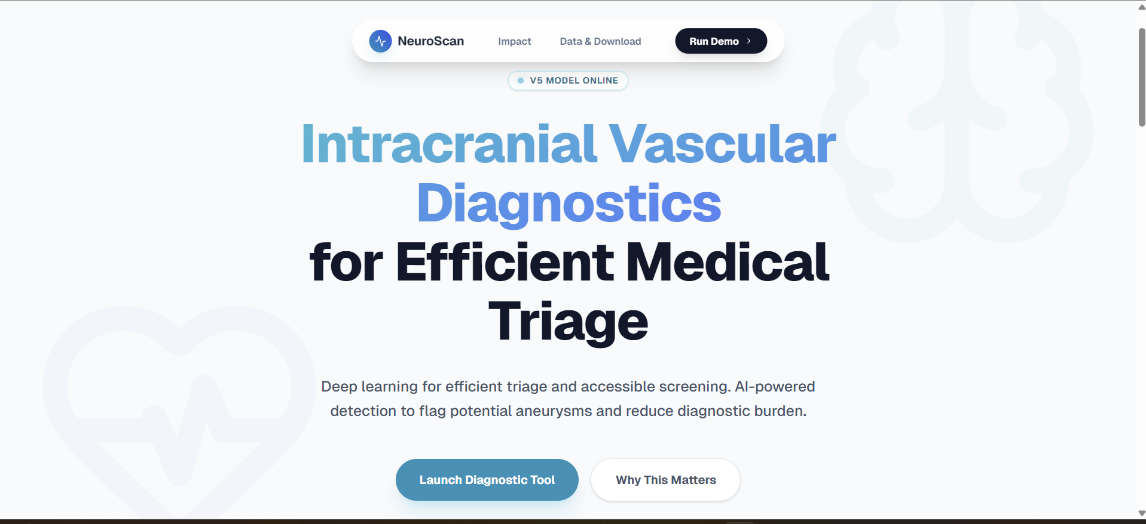
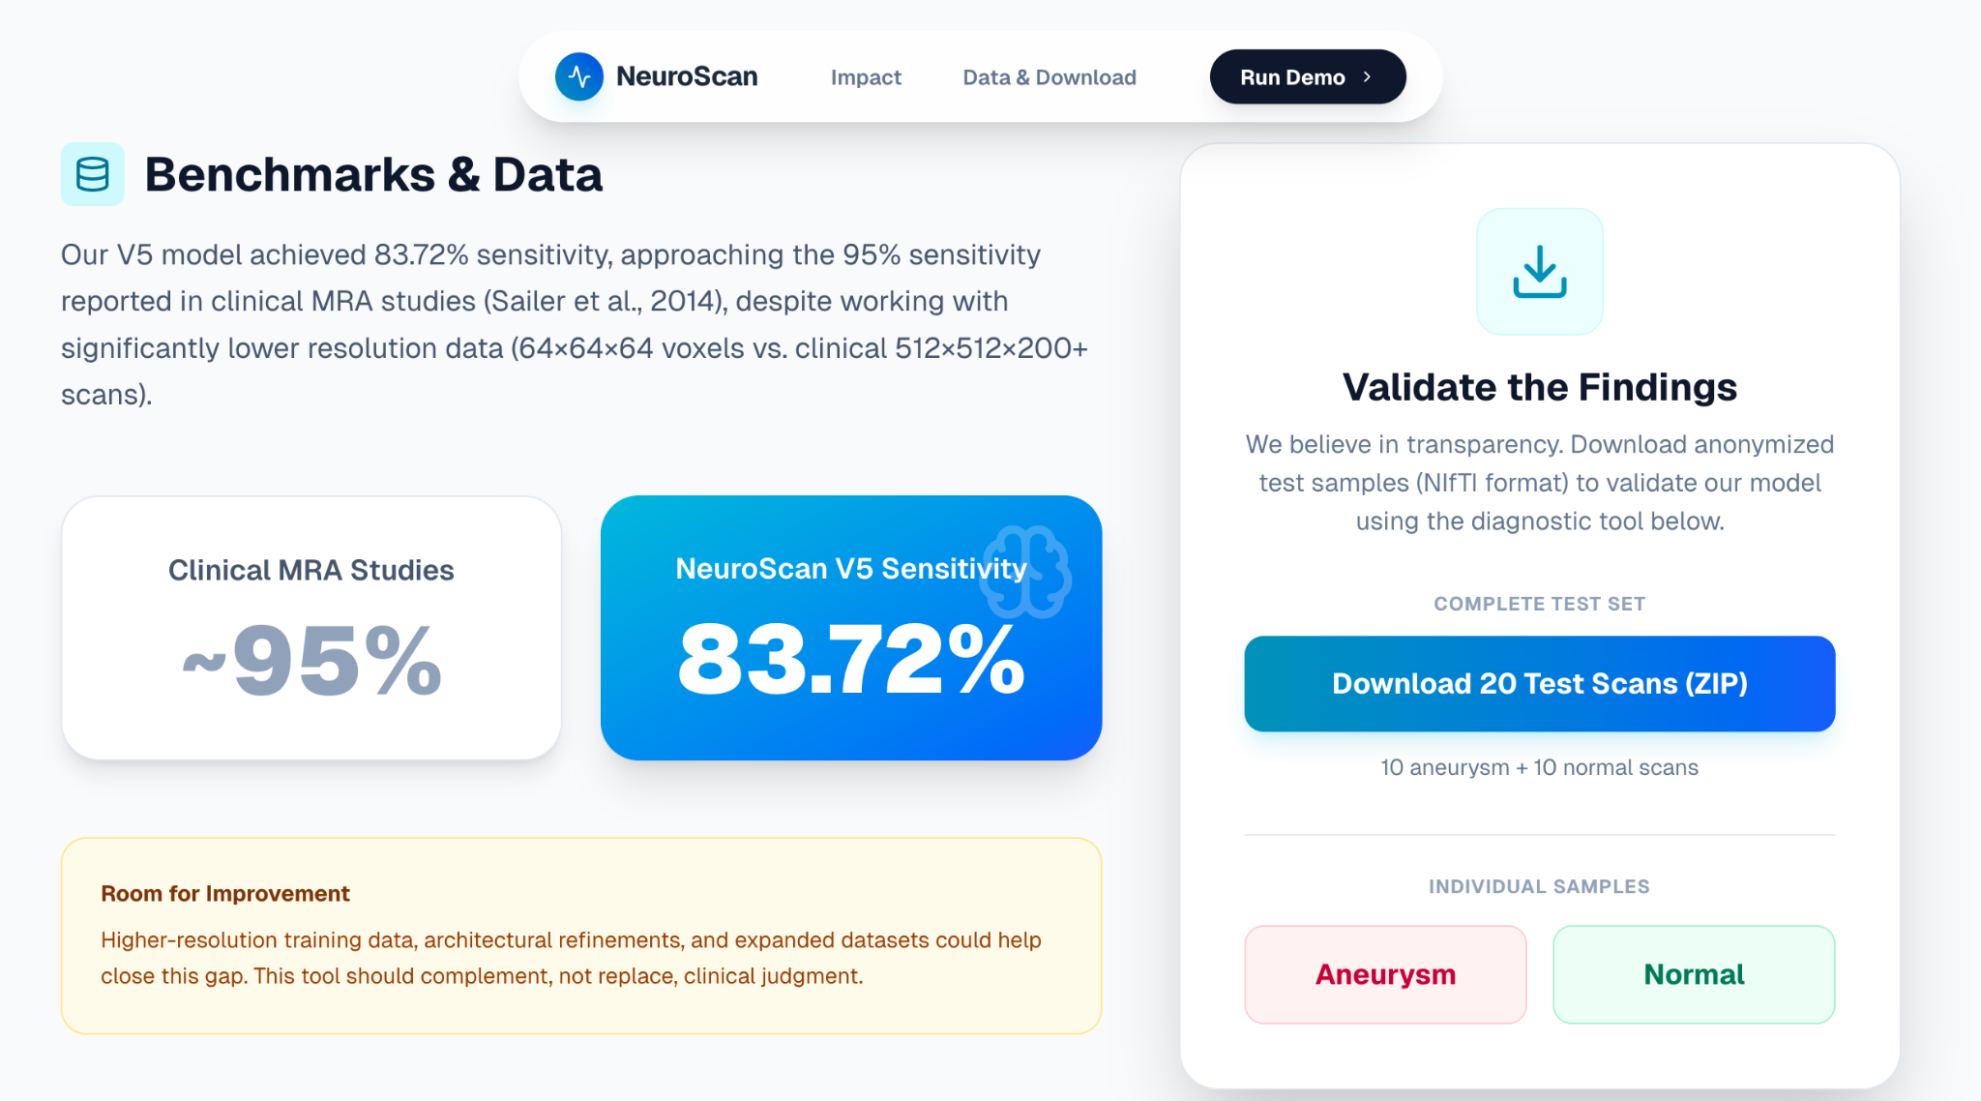
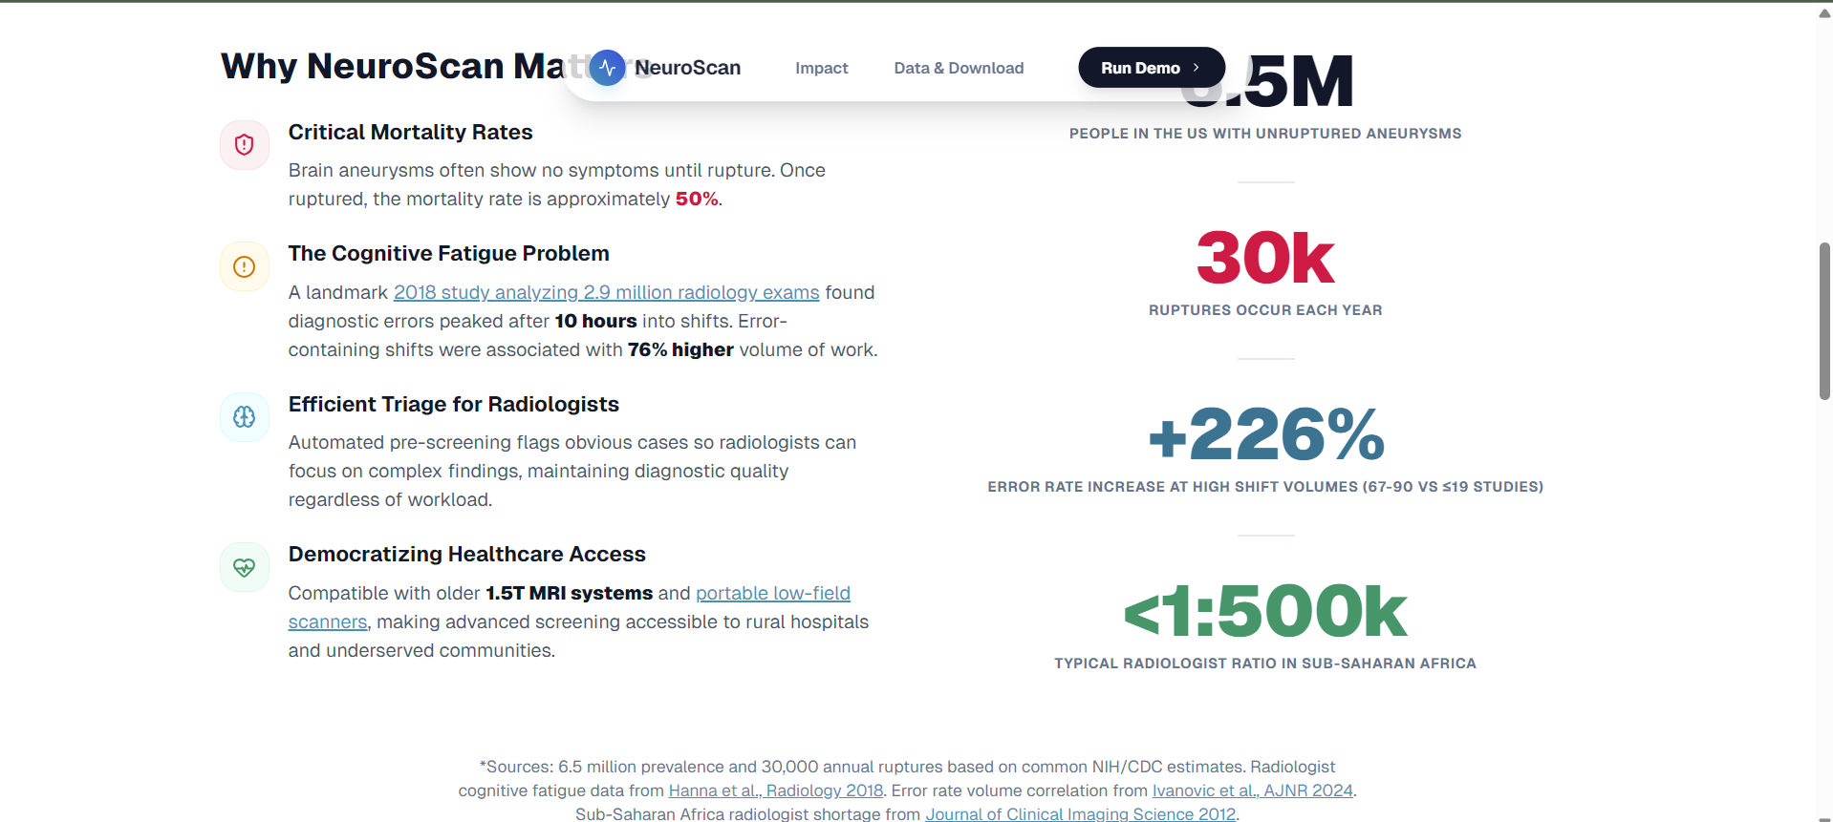
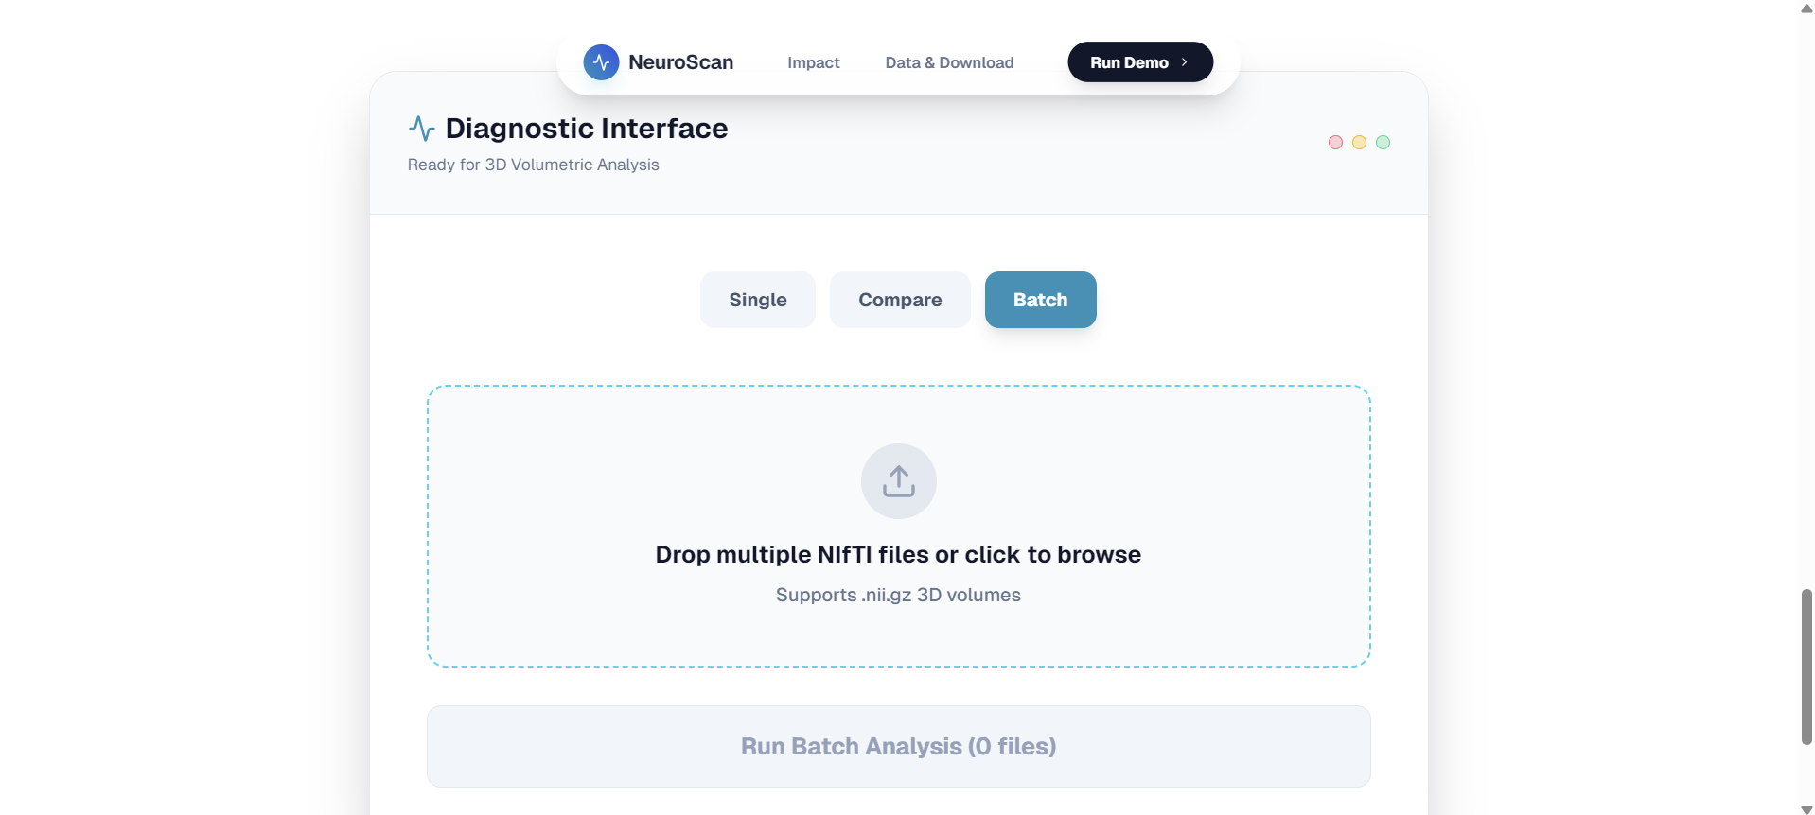
Model Results
Model | Accuracy | Recall | Precision | Missed
V1 (8.0) | 86.65% | 81.40% | 44.87% | 8
V2(12.0) | 89.53% | 83.72% | 52.17% | 7
V3(9.0) | 90.58% | 81.40% | 55.56% | 8
V4(8.5) | 84.82% | 81.40% | 41.18% | 8
V5(7.5) | 90.05% | 83.72% | 53.73% | 7
Why We Chose V5:
Tied for best recall (83.72%) - catches the most aneurysms
Only 7 missed aneurysms (fewest false negatives)
Strong precision (53.73%) - balanced false alarm rate
High overall accuracy (90.05%)
Notes:
Here is a preview of our website. It has 4 main sections. The landing page provides the main introduction and value proposition of the project. The Impact Section explains the clinical and social justification for the tool. Then we have a section which presents our model's 83.72% sensitivity and provides downloadable test samples for transparency and validation. The main tool is the diagnostic interface which is a live demonstration of our fully deployed machine learning model.

Slide 15

WHERE TO FIND THE PROJECT
GITHUB
https://github.com/KarenMazaDelgado/Neuroscan-Frontend
Notes:
Karen: We pushed the finalized code to a dedicated GitHub Repository which includes the model. Feel free to take a look at our code!

Slide 16
High-Level Overview - WEB APPLICATION
TECH STACK: Next.js (React framework), Gradio, HuggingFace | DEPLOYED: Vercel
LINK: https://neuroscan-frontend.vercel.app/
Overview:
Next.js (React Framework) - Hosts the User Interface, handling file uploads, displaying the NIfTI viewer, and provides the Secure Proxy for external API calls.
Gradio - Gradio's job is to provide a simple, standardized API to wrap the Python classification model for web consumption
Vercel + HuggingFace - Vercel hosts and serves the Next.js Frontend. Hugging Face hosts and runs the heavy-duty Gradio Backend
Notes:
Karen: For the architecture of the site, We decided to use Next.js to build a high-quality, professional user interface for uploading files and displaying results.
Next we chose Gradio to act as an API Wrapper. It allows us to take our Python MONAI model and expose it as a clean, standardized API endpoint.
It also allows us to use HuggingFace, which provides free, scalable cloud infrastructure for our Python backend. The HuggingFace space runs the Gradio application, offering a public URL where our model can listen for requests.
Finally, We chose Vercel because it is the native and most optimized platform for deploying Next.js applications. This gives us fast load times and automatic scaling.

Slide 17
FRONTEND DEPLOYMENT - RESULTS VISUALIZATION
NIFTI VIEWER - INTERACTIVE 3D VISUALIZATION
Tech Stack: Niivue.js | Next.js
How it works:
Receive Data - Backend sends 3D MRI scan + AI heatmap + confidence score as base64 text
Decode & Load - Convert to binary, load both volumes into Niivue 3D viewer
Multi-View Display - 4 synchronized angles (side, front, top, 3D) of vessel segment
Heatmap Overlay - AI detections of abnormalities displayed from yellow to red color intensity on scan
Interactive Navigation - Click, zoom, and explore slices in real-time
Notes:
Chimin
After the AI model analyzes an MRI scan, we wanted to display the results in a format that medical professionals and users can understand and interact with
NIFTI is the industry-standard file format for storing medical imaging data, containing three-dimensional volumetric data - thousands of individual slices stacked together to create a complete 3D representation of the brain or blood vessels
Traditional image viewers cannot handle this type of volumetric data, so we used Niivue.js: a specialized JavaScript library designed specifically for rendering medical imaging data in web browsers. It leverages WebGL, which is a graphics rendering technology that allows us to display complex 3D visualizations.
Next.js: Our web application framework, which provides the structure for our frontend application
1) Receive Data: The backend server processes the uploaded MRI scan through our AI model and then transmits three pieces of information back to the frontend: the original 3D MRI scan, the AI-generated heatmap showing potential abnormalities, and the confidence score. These files are encoded as base64 text strings to facilitate transmission over the internet.
2) Decode and Load: Our frontend application converts these text strings back into binary data format, which the visualization library can process. We then load both the original scan and the AI heatmap into the Niivue viewer as separate but overlapping layers.
3) Multi-View Display: The viewer presents four synchronized perspectives simultaneously. This multi-planar approach is standard in medical imaging because it allows clinicians to examine the anatomy from multiple angles:
wont go into this too much; we will do a demo later
4) Heatmap Overlay: The AI model's predictions are visualized as a color-coded heatmap overlaid on top of the original scan. We use a warm color gradient - yellow indicates low-level concerns, orange indicates moderate suspicion, and red indicates areas where the model has detected strong indicators of potential aneurysms. This visual representation allows users to immediately understand not just whether an aneurysm was detected, but precisely where in the 3D space the model identified abnormalities
This visualization component serves several critical functions:
1) transparency - users can see exactly where the AI model detected abnormalities, rather than just receiving a binary yes/no diagnosis.
2) verification - medical professionals can validate the AI's findings by examining the highlighted regions themselves.
3) accessibility - complex medical imaging analysis is presented through an intuitive web interface that requires no specialized software installation. Any authorized user with a web browser can access and examine these detailed 3D visualizations.

Slide 18
BACKEND DEPLOYMENT - RUNNING MODEL AND GENERATING HEATMAP
TECH STACK: Python | hosted on HuggingFace Spaces
https://huggingface.co/spaces/cooleschimo/neuroscan-backend
How it works:
File Upload - Gradio API receives NIFTI scan file from frontend
Preprocess MRI scan - MONAI framework normalizes and prepares 3D scan data for model
AI Inference - PyTorch-based CNN (V5 model) analyzes scan and predicts classification
Generate Heatmap - GradCAM3D creates heatmap showing where model detected abnormalities
  Challenge!
Notes:
Chimin
backend is deployed on Hugging Face Spaces, which provides free hosting for machine learning applications. The entire inference pipeline is written in Python and uses Gradio to create an API that our frontend can communicate with
1) When a user uploads a NIFTI scan through our web interface, the file is sent to our Gradio API endpoint. Gradio handles all the HTTP communication
2) MONAI - Medical Open Network for AI - is a PyTorch-based framework specifically designed for medical imaging. It handles normalization, ensuring the scan data is in the correct format and scale for our model. Medical images can vary widely in intensity ranges, so normalization is critical for consistent predictions
3) AI Inference: Our V5 model is a 3D convolutional neural network built with PyTorch. Ousman has covered this earlier
4) GradCAM3D Heatmap Generation: GradCAM - Gradient-weighted Class Activation Mapping - is a technique that visualizes which parts of the input the model focused on when making its decision. It works by analyzing the gradients flowing through the final convolutional layers of the network. Areas with high activation get colored red in our heatmap, showing where the model detected suspicious features. This provides transparency and allows medical professionals to validate the AI’s reasoning
Challenge: Making GradCAM3D Work Properly

Slide 19
CHALLENGE: Identifying a suitable layer for the heatmap
ResNet Architecture
Input
Layer 1
Layer 2
Layer 3
Layer 4
Pooling
Output
64 x 64 x 64
32 x 32 x 32
16 x 16 x 16
8 x 8 x 8
4 x 4 x 4
1 x 1 x 1
Aneurysm features (semantic)
Classification Decision
Textures & patterns
Vessel shapes & curves
Edges & boundaries
Raw vessel voxels
Even after hooking on this layer, heatmap was still highlight everything
Sensitivity threshold too low (10%) -> 15%
Initially hooked onto this layer, heatmap was highlighting everything
layer4[-1].conv2
Notes:
Chimin
One of the key technical challenges in implementing GradCAM was identifying which layer in ResNet-18 would give the most meaningful visualizations of the model's decision-making process.
Architecture Overview (20-25 seconds)
ResNet-18 has this hierarchical structure with four main layer groups. Each group contains two residual blocks, and each block has two convolutional layers—so that's four conv layers per group, giving us 16 convolutional layers total across these four groups, plus an initial conv layer.
As data flows through, spatial dimensions progressively shrink—from 64-cubed at the input down to 4-by-4-by-4 at Layer 4—while features become increasingly abstract
The Initial Mistake - Layer 3
"Initially, I hooked GradCAM into Layer 3, which operates at 8-by-8-by-8 resolution. My reasoning was that Layer 3 captures geometric features—curves, bends, vessel shapes—which seemed perfect for detecting aneurysms, since aneurysms are geometric abnormalities.
However, the heatmap was still highlighting everything, including healthy vessels. Layer 3 understands shapes, but it doesn't understand which shapes are clinically significant.
I moved to Layer 4—specifically layer4, block -1, conv2. That's the second convolutional layer in the final residual block, which is the 17th and last convolutional layer before classification.
I realised this is where the network has learned the semantic concept of 'aneurysm', not just any bulge or curve, but the specific morphological patterns that indicate pathology.
it was still highlighting noise, so I increased the activation threshold from 10% to 15%. Now the heatmap only displays activations above 15% of the maximum value, filtering out weak background noise and showing only the regions where the model has strong, focused attention.

Slide 20
Implications
Clinical Standard vs. Reality
Value Proposition 1: High-Volume Triage
NeuroScan Performance
Value Proposition 2: Accessibility in Underserved Areas
While MRA studies report pooled sensitivity of 95%, individual radiologist performance varies significantly with workload
Global radiologist shortage may lead to high-volume shifts that increase error rates through cognitive fatigue.
Sensitivity: 83.72%
Role: Acts as a rapid "First-Read" safety net rather than a standalone diagnostician.
Automating detection of "obvious" pathologies reduces cognitive load.
Allows radiologists to preserve mental energy for complex, minute (<3mm) abnormalities where human expertise is irreplaceable.
Provides critical diagnostic support in low-resource settings (e.g., rural hospitals, developing regions).
Model trained on scans typically produced by older, lower-resolution MRI hardware often found in these regions.
Notes:
Maria
This slide highlights the real-world implications of our work. First, clinically, radiologists have about 95% sensitivity, but in reality many hospitals deal with severe radiologist shortages. That leads to fatigue, which can increase diagnostic errors, especially in high-volume settings. Next, NeuroScan’s performance shows an 83.72% sensitivity. The key point is that we are not positioning the model as a standalone diagnostician. Instead, it acts as a rapid *first read* safety net that helps flag potential aneurysms quickly. Our first value proposition is high volume triage. The model helps automatically detect obvious abnormalities so radiologists can preserve their focus and mental effort for more complex, subtle cases. Our second value proposition is accessibility. This tool provides diagnostic support in underserved or resource limited regions, including rural hospitals or developing areas. Because the model was validated on lower-resolution MRI scans, it remains useful even on older hardware that is common in those settings.

Slide 21
DEMO
Notes:
Chimin

Slide 22
Essential Question: How can the process of creating AI/ML solutions amplify or mitigate bias in the case of NeuroScan?
How we could amplify bias:
VesselMNIST3D may not represent all populations (age, geography, scanner types) → Model could underperform on underrepresented groups
Overworked radiologists may over-trust AI during fatigue
Deployment inequality: Under-resourced settings with less oversight → higher harm potential
How we mitigate bias:
Radiologists can verify model classification through the visualization to catches false correlations early
Could generalize better than high-resolution-only models
Transparent dataset and reproducible results → community can audit for bias
Notes:
Chimin

Slide 23
Next Steps
Model Improvements
  Higher resolution training (128³ or 256³) for detecting small aneurysms (<3mm)
  Reduce false positive rate (currently 47.8%) through threshold optimization
  Test alternative architectures (3D U-Net, attention mechanisms)
Clinical Validation
  Real-world MRA data testing beyond VesselMNIST3D benchmark
  Multi-site validation (academic, community, rural hospitals)
Bias & Equity
  Performance audit stratified by age, sex, scanner type, aneurysm size
  Test on diverse equipment (1.5T vs 3T, older vs newer systems)
Research Extensions
  Aneurysm localization + size estimation (beyond binary classification)
  Rupture risk prediction
Notes:
Chimin

Slide 24
Acknowledgments
Instructor: Karl Jaehnig, for their guidance and support throughout this project
Mentor: Mohammed Amine Gharsallaoui, for his expertise and invaluable feedback on model development
Facilitator: Padina Nasiri Toussi, for her dedication and assistance during the AI4ALL Ignite Program
AI4ALL Program For providing this incredible learning opportunity
Our Team For collaboration, hard work, and dedication to this project
Notes:
Fola

Slide 25
Resources
Xi Yang, Ding Xia, et al., “Intra: 3d intracranial aneurysm dataset for deep learning,” inProceedings of the IEEE/CVF Conference on Computer Vision and Pattern Recognition (CVPR), June 2020.
Jiancheng Yang, Rui Shi, Donglai Wei, Zequan Liu, Lin Zhao, Bilian Ke, Hanspeter Pfister, Bingbing Ni. Yang, Jiancheng, et al. "MedMNIST v2-A large-scale lightweight benchmark for 2D and 3D biomedical image classification." Scientific Data, 2023.
Yang, J., Shi, R., Wei, D., Liu, Z., Zhao, L., Ke, B., … Ni, B. (2023). MedMNIST v2 - a large-scale lightweight benchmark for 2D and 3D Biomedical Image Classification. Scientific Data, 10(1). doi:10.1038/s41597-022-01721-8
Deng, Zhiwei, et al. “Shape-Aware 3D Small Vessel Segmentation with Local Contrast Guided Attention.” Lecture Notes in Computer Science, 1 Jan. 2023, pp. 354–363, pmc.ncbi.nlm.nih.gov/articles/PMC10948105/, https://doi.org/10.1007/978-3-031-43901-8_34. Accessed 15 Oct. 2025.
Hanna, T. N., et al. (2018). Effect of shift, schedule, and volume on interpretive accuracy: A retrospective analysis of 2.9 million radiologic examinations. Radiology, 287(1), 205-212. https://pubs.rsna.org/doi/abs/10.1148/radiol.2017170555
Ivanovic, V., et al. (2024). Shift volume directly impacts neuroradiology error rate at a large academic medical center: The case for volume limits. American Journal of Neuroradiology, 45(4), 374-378. https://pmc.ncbi.nlm.nih.gov/articles/PMC11288559/
Cooley, C. Z., et al. (2021). A portable scanner for magnetic resonance imaging of the brain. Nature Biomedical Engineering, 5, 229-239. https://www.nature.com/articles/s41551-020-00641-5
Ouma, J., et al. (2012). Imaging in sub-Saharan Africa: Current challenges and opportunities. Journal of Clinical Imaging Science, 2, 44. https://pmc.ncbi.nlm.nih.gov/articles/PMC3424787/

